Slide 1
SQL

Slide 2
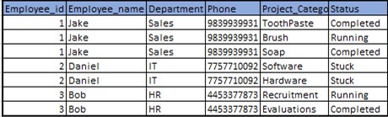
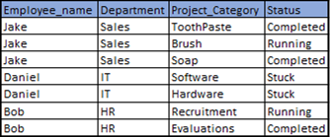
RDBMS
RELATIONAL database management systems
Use tables for storing data (Rows and Columns)
These tables are not stand alone flat files, They are “Related” :)
Repetitive records
Difficult to ensure privacy
More storage required
Compromise on integrity
Difficulty in deleting, updating, accessing
Notes:
What if a new project is to be added? A new file is to be added in both the files. What if Daniel changes his number? And then a new project is assigned to Daniel, Would you put new number?? What if another Project is assigned to Daniel? What number will you use?
You are required to fill all fileds for a record.
Clash of information here will compromise data integrity.

Slide 3
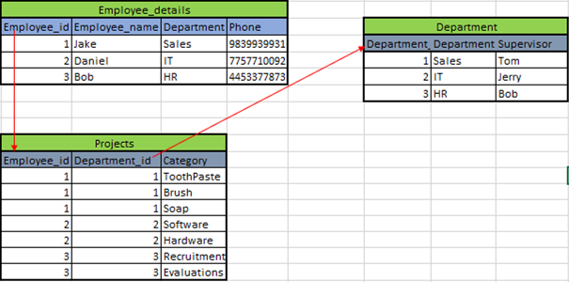

Solution
Notes:
Primary key and foreign key
Privacy for each table can be controlled, updating records is easy, ensures uniformity, no duplicate information.
Normalized data,

Slide 4
Analysts and Scientists are not Admins :)
DBAs (Database administrators)
Responsible for maintaining database servers and databases in healthy condition
Designs, manages, upgrades, migrates databases
Controls access and permissions
Data Analyst / Scientists
Mines data and puts data into use
Accesses data bases and derives insights from the data
Requires access to the database

Slide 5
What’s SQL? Why use it?
SQL is a programming language used to interact with RDBMS.
It’s used to ‘Query’ a database, i.e requesting information from a database.
Why use SQL?
Simple to use
Best way to access structured data/Transactional data
Standard coding across all platforms
High in demand; Significant data we have is still structured/transactional
Most demanded programming language

Slide 6
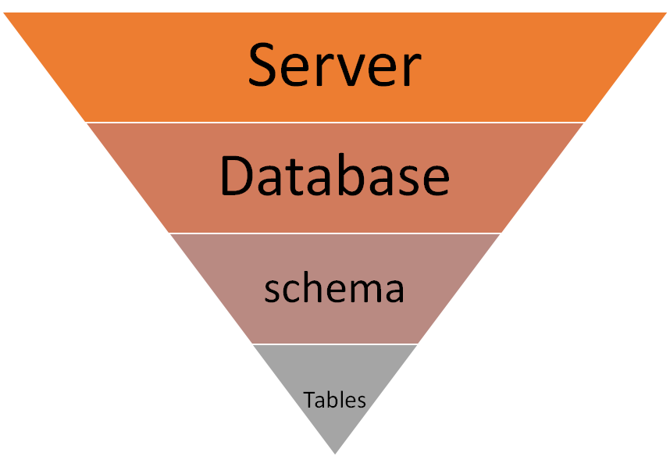

Database mgt
RDBMS
SQL
Notes:
Explain difference between postgresql and Pgadmin4

Slide 7
Let’s get down to business
Create database
Restore database
Restore database schema only
Connect to a database

Slide 8
Exploring a database
SELECT statement :
SELECT column1,column2...columnN FROM table_name
SELECT DISTINCT:
SELECT DISTINCT column1,column2 FROM table_name
SELECT * FROM table_name will select all columns
SELECT sales AS Quarter3_sales from table_name (selecting while renaming the new column)
SELECT sales/3 As monthly_sales from table_name ( Math operators can be used with select)
Using (*) is not advisable

Slide 9
Selecting with conditions
Example:
SELECT Name,Age
FROM Student_Data
WHERE Age >= 14;
SELECT column1,Column2
FROM table_name
WHERE conditions;
Selecting filters columns , where filters rows.
You don’t need to select the column you are applying conditions to

Slide 10
Selecting with conditions
Example:
SELECT Name,Age
FROM Student_Data
WHERE Age >= 14;
SELECT column1,Column2
FROM table_name
WHERE conditions;
Selecting filters columns , where filters rows.
You don’t need to select the column you are applying conditions on

Slide 11
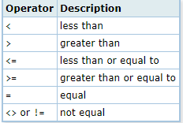
Operators available
Operator | Description
Between a and b | Value between low and high
Not Between a and b | Value not between low and High
Like, Not Like | Looks for pattern
iLike,Not iLike | Pattern but case insensitive
IN, Not IN | Specify list of values
Use AND and OR to combine multiple conditions
Select all columns from film, for records that have rental duration between 3 and 6 title starting with ‘A’ and rating is either ‘PG’ , ’R’ or ‘G’
Notes:
% in like refers to any number of characters, _ refers to single character, Use ilike for case insensitivity.
select first_name,email from customer
where first_name ilike 'k%ar%n'
Will have karen in result.
% means there can be or not be any character between on that position. Underscore requires 1 character
select * from film
where rental_duration between 3 and 6 and
title like 'A%' and
rating in ('PG','R','G')

Slide 12
# of rows and # of distinct values
SELECT COUNT (*) From Table_name
This will return total number of rows in a table.
SELECT COUNT(First_Name) From Customer
This will return Number of rows where first_name is not null
SELECT COUNT(DISTINCT(TITLE)) From Film
Will return number of distinct movie titles in film data set.

Slide 13
Limit # of returned rows and Sort
Limits number of returned rows to number specified
Select * from table
Limit 20;
Orders data in desired order
Select * from table
Order by first_name desc;
Limits are useful when you are working on huge tables, They help in reducing the query execution time.
Desc shows descending order, if nothing is specified default is ascending.
The column used for sorting does not need to be selected.
Multiple variables can be used and seperated wiht ‘,’ .
Select the last 10 payments that were made
Notes:
select * from payment
order by payment_date
limit 10;

Slide 14
Aggregate functions
SUM, MIN, MAX, AVG
SELECT SUM(Amount) from Payments;
SELECT AVG(Amount) from Payments;
SELECT ROUND(AVG(Amount),2) From Payments;
Group By
SELECT AVG(Amount) from Payments;
GROUP BY customer_id;
Write a query to show average amount paid by customer to each staff. Name the returning average column as ‘Avg_Amount’
Notes:
select round(Avg(amount),2) as average_payment,customer_id,staff_id from payment
group by customer_id,staff_id

Slide 15
Group By and Having
To filter the rows generated by group by using Having.
SELECT AVG(Amount), Customer_id
FROM Payments
WHERE staff_id =1
GROUP BY customer_id
HAVING AVG(Amount) > 3
Where filters the data before grouping it, Having filters the data after Grouping it.
Notes:
select avg(amount) as average_Amount,customer_id
from payment
where staff_id = 1
group by customer_id
having avg(amount) > 3

Slide 16
EXERCISES
Get the top 5 films that have highest replacement costs. Print titles of films and their replacement costs.
How many customers are no longer active (use active-integer).
Write a query to fetch all customer first names and last names , where the first names begins with A and ends with y.
Which special features have average rental rate higher than $3.00
Notes:
Ans:1
select title,replacement_cost from film
order by replacement_cost desc
limit 5
Ans: 4
select round(Avg(rental_rate),2),special_features from film
group by special_features
having Avg(rental_rate)>3.00

Slide 17
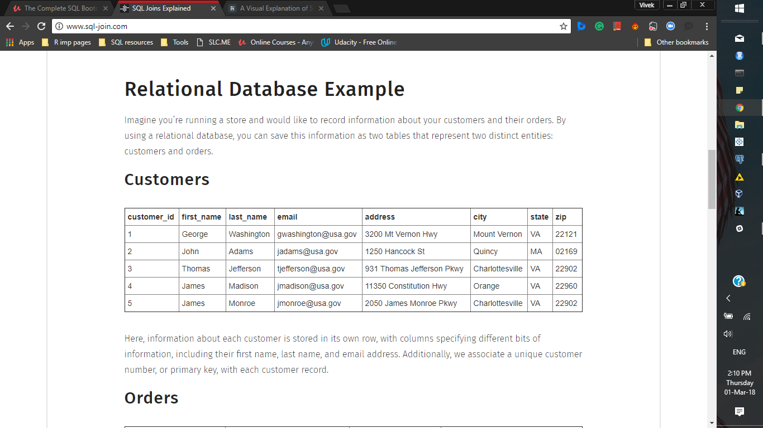
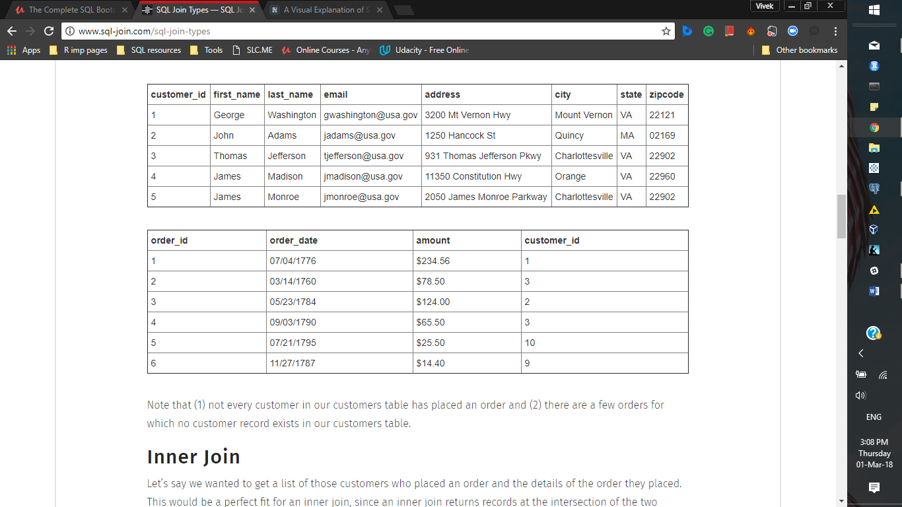
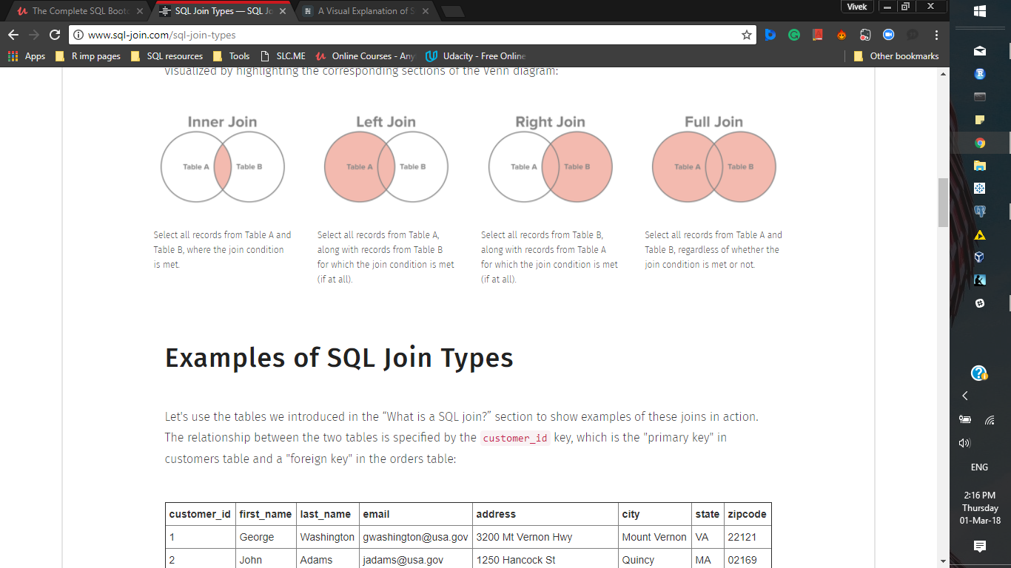
Joining Tables

Slide 18
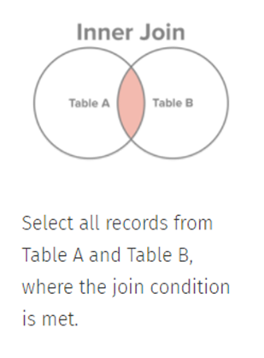
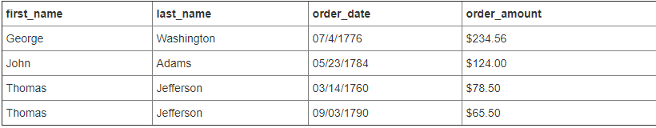
Inner join
SELECT first_name,last_name,order_date,order_amount
FROM customers
INNER JOIN orders ON customers.customer_id=orders.customer_id
Note that the column used for joining does not need to be selected.

Slide 19
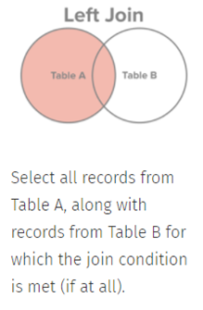
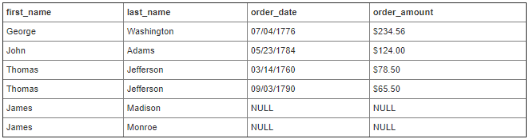
Left Join
SELECT first_name,last_name,order_date,order_amount
FROM customers
LEFT JOIN orders ON customers.customer_id=orders.customer_id
Appends data side by side.This can be useful if you want to find customers that havent placed any orders. Add a where condition to do this.
Notes:
Where order_date is NULL

Slide 20
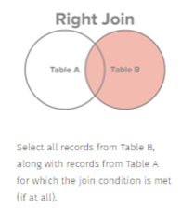
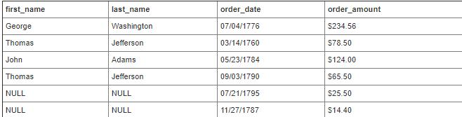
Right Join
SELECT first_name,last_name,order_date,order_amount
FROM customers
RIGHT JOIN orders ON customers.customer_id=orders.customer_id
Note that if the order of tables is changed it is as good as changing the join type from left to right.
Notes:
Where order_date is NULL

Slide 21
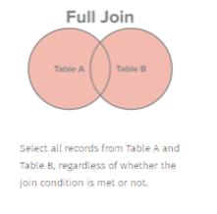
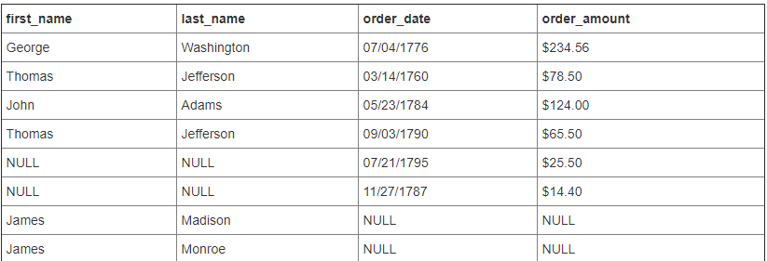
Full join
SELECT first_name,last_name,order_date,order_amount
FROM customers
FULLJOIN orders ON customers.customer_id=orders.customer_id
Returns all rows from both the tables, Does not repeat matching rows.
Notes:
Where order_date is NULL

Slide 22
More on joins
If same columns exists in the tables that are being joined , specify table name before the column name in the select statement.
More than two tables can be joined in a single query provided that they have common columns.
Example :
SELECT customer.Customer_id,Product_id,Ship_date
From customer
INNER JOIN Product ON customer.customer_id=Product.Product.id
INNER JOIN Shipments ON product.product_id=Shipments.Product.id

Slide 23
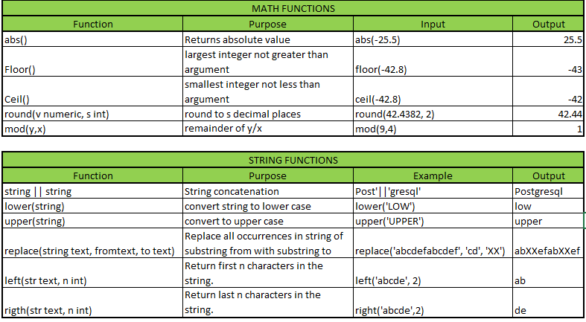
Math Function and String operations

Slide 24
Exercise
PART-I
Which staff member has higher average payments ? Get the name of this staff member ?
Fetch the names of films that had rating ‘PG’ , Who were the actors in the films, get their names. Requirements( Title, Actor full name(in one column) and rating.)
Which category has the highest number of films ? what is the average length of films in this category? Get the name of this category . (Requirements : Number_of_films, Average_length,Name of category)
Notes:
Ans 1.
select round(avg(amount),2),first_name,last_name
from payment
inner join staff on payment.staff_id = staff.staff_id
group by staff.first_name,staff.last_name
order by avg(amount) desc;
Ans 2.
select rating,title,first_name ||' '|| last_name as Actor_name
from film
inner join film_actor on film.film_id=film_actor.film_id
inner join actor on film_actor.actor_id=actor.actor_id
where rating='PG'
Ans 3.
select count(*) as number_of_films,round(avg(length)) as average_length,name
from film
inner join film_category on film_category.film_id=film.film_id
inner join category on film_category.category_id=category.category_id
group by film_category.category_id,category.name
order by number_of_films desc

Slide 25
Working with date functions and extracts
Extract function helps you extract information from a timestamp.
Syntax :
Extract(unit from timestamp_column)
Example :
Select Extract(day from payment_date) as day_of_month.
Functions :
age(timestamp,timestamp)
Current_date
Current_timestamp
You can also use mathematical operators over dates eg:
current_date-Payment_date
More details available here:
https://docs.google.com/presentation/d/1425ITAzfuo9p65EMt9yPGJbohfh9tbBKjeTSsvDIu0o/edit#slide=id.g348ea9809f_0_113
Formatting dates :
Returning Days, Week, Hour of day etc.
To_char(payment_date,’Day’)
to_char(payment_date,’YYYY’)
to_char(payment_date,’HH12’
More details available here:
https://www.postgresql.org/docs/10/static/functions-formatting.html

Slide 26
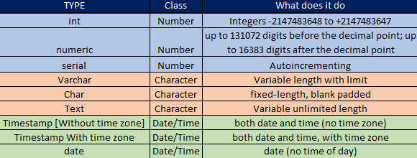
Data types

Slide 27
Create tables (DDL)
Syntax :
CREATE TABLE Table_name (Var1 var_type constraints, Var2 Var_type constraints……)
Constraints help you control the values that go into each field in a table , Below are some constraints :
CHECK : checks if a condition is true
UNIQUE : Ensures that a field has unique values
NOT NULL: Makes sure that a field is not left blank

Slide 28
Modify tables (DML)
Modifying tables includes updating tables, altering tables,adding or deleting data,changing data types.
Updating means changing data :
UPDATE payment
SET staff_id=2 WHERE payment_id=17503
Alter: Adding/removing columns:
ALTER TABLE payment
ADD cash numeric not null
ALTER TABLE payment
DROP cash
ALTER TABLE payment
ALTER COLUMN payment_id TYPE varchar
Inserting data:
INSERT into payment (var1,var2…)
VALUES (123,’ABC’...)
Deleting data
DELETE from Payment
WHERE payment_id=1734

Slide 29
Importing & exporting CSVs
Importing from a CSV :
COPY table_name FROM 'D:\work\myfolder\data.csv' delimiter ',' csv header;

Slide 30
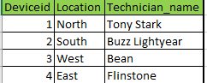
Exercise
Create a table that shows yearly average temperatures.
Produce a table that shows monthly minimum,maximum and average temperature (Month names should appear)
In the device_details table add a column device_tag, the value for this column are first letter of name+’_’+deviceid+first letter of location
For north region the temperature never went above 35, correct all such entries by replacing the temperature with 35
PART-2
PART-II
Import sensor_data.csv
Create the following table,call it device_details :
Constraints :
Deviceid should not be blank
Location can only have North, South, West, East
Technician name should be unique and not blank
Notes:
1 :
create table sensor_data (Deviceid int,temprature numeric,Time timestamp without time zone)
set datestyle to SQL,DMY;
copy sensor_data from 'X:\work\SQL\SQL resources\BootCamp\sensor_data.csv' delimiter ',' csv header;
2 :
create table device_details (Deviceid int not null
,Location varchar(20) check (location in ('North','South','West','East'))
,Technician_Name varchar(100) not null unique)
3:
insert into device_details (deviceid,location,technician_name)
values (1,'North',Tony Stark),
(2,'South','Buzz Lightyear'),
(3,'West','Bean'),
(4,'East','Flinstone')
Avg by year:
select extract (Year from time) as year,round(avg(temprature),2) as Average_temp
from sensor_data
group by year
Monthly Min and Max
select to_char(time,'Month') as Month,
round(min(temprature),2) as Minimum,
round(max(temprature),2) as Maximum
from sensor_data
group by month
Device_tag :
alter table device_details
add device_tag varchar unique
update device_details
set device_tag = left(technician_name,1)||deviceid||left(location,1)
North correction
update sensor_data
set temprature=35 where deviceid=1 and temprature>35

Slide 31
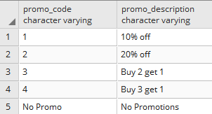
PROJECT
Creating database for market research firm
Use the CSV files to create a database for this firm. Create the below table
Notes:
1:
create table sales (Instance_id serial,Product_id Int,Store_id int,Week_id int,quantity int,Promo bool,Promo_code varchar(20))
copy sales from 'X:\work\SQL\SQL resources\BootCamp\sales.csv' delimiter ',' csv header;
2:
create table stores (store_id int,Retailer varchar(100),City varchar(100))
copy stores from 'X:\work\SQL\SQL resources\BootCamp\stores.csv' delimiter ',' csv header;
3:
create table products (product_id int, Brand Varchar(50), Manufacturer varchar(50), Category varchar(50))
copy products from 'X:\work\SQL\SQL resources\BootCamp\Product.csv' delimiter ',' csv header
4:
create table weeks (week_id int,weekend_date date)
copy weeks from 'X:\work\SQL\SQL resources\BootCamp\Weeks.csv' delimiter ',' csv header
5:
insert into promo (promo_code,Promo_description)
values('1','10% off'),
('2','20% off'),
('3','Buy 2 get 1'),
('4','Buy 3 get 1'),
('No Promo','No Promotions')
6:
select to_char(weekend_date,'Month') as Month, Sum(quantity)
from sales
inner join weeks on sales.week_id=weeks.week_id
where sales.week_id > 104
group by Month
order by sum(quantity) desc
7:

Slide 32
Help them answer the below questions :
Which month has the maximum total sales in the last one year?
Which Promotion works the best?
Which manufacturer is the leader in sales of Laundry detergent?
Connect this database to R and create the following visualization :
Create a bar chart that shows average quantity sold during each promotion

